Slide 1
A1. Petroleum generation modeling
Alina Khayrullina
Daniil Sherki
Evgeny Serebrennikov
Timur Zakarin

Slide 2
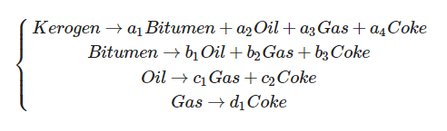
According to organic theory of petroleum genesis:
, where 𝑎𝑖 , 𝑏𝑖 , 𝑐𝑖 , and 𝑑𝑖 – stoichiometric coefficients.

Slide 3
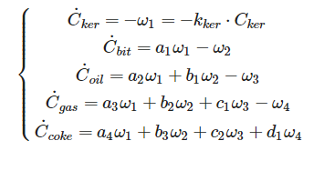
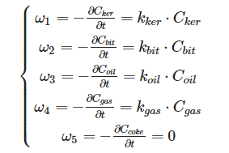
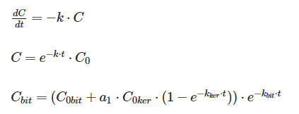
According to law of mass action, velocity of decomposition reaction equal ω=kC^{n}_{ker} , when ω - velocity of the reaction, k - constant of velocity reaction, n - reaction order It is a decomposition equation, that means the order of the reaction will be equal to 1.
Therefore, velocity of decomposition reaction for every component equal
In the next step, we need to find velocity of formation reaction every component

Slide 4
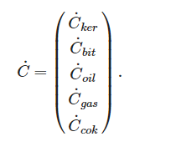
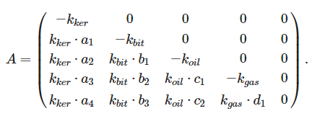
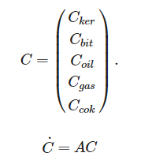

System of differential equations in matrix form:

Slide 5
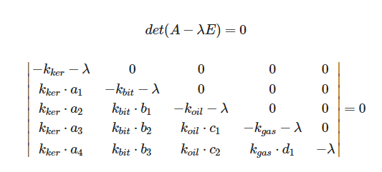
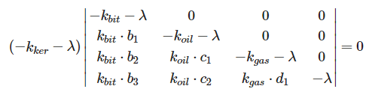
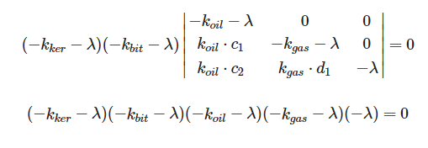
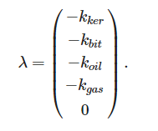
Eigenvalues of matrix:

Slide 6
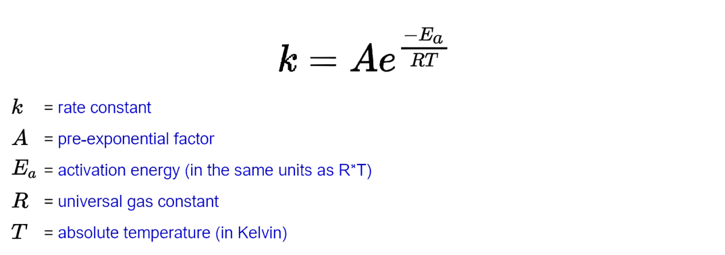
Arrhenius law formula

Slide 7


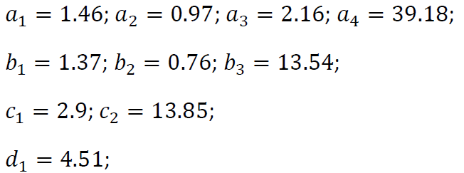

Initial data
Perform numerical integration of the differential equation system using Matlab or Python. Take:
Pre-exponential factors:
Activation energies:
Molar masses:
Stoichiometry coefficients:
Consider two different temperature conditions:
How do the results change?
How does +/- 5% alteration of each activation energy influence the results? Provide the graphs

Slide 8
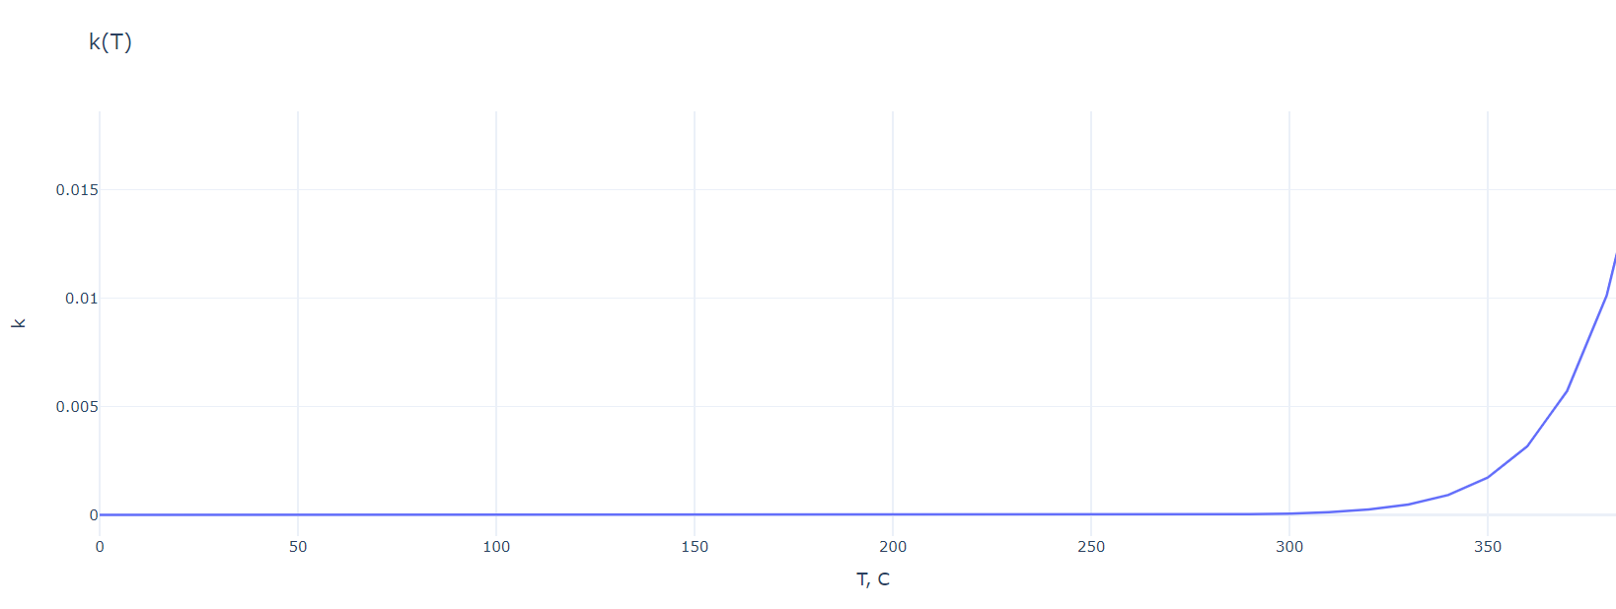
Dependency graph of k on T

Slide 9
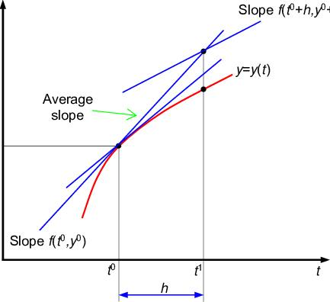
Solving the differential equation system. Runge-Kutta method

Slide 10
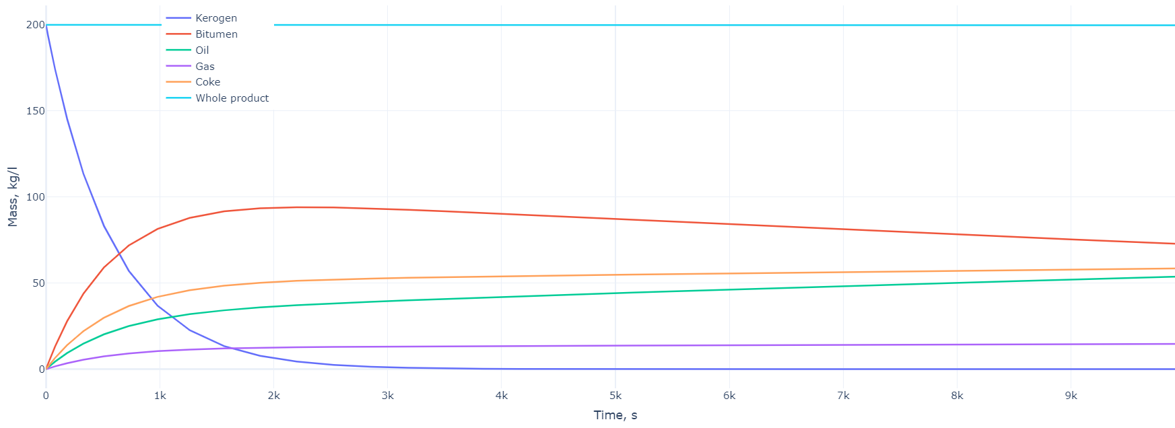
Graph of changes in the mass of components over time (for T = 350 ℃)

Slide 11
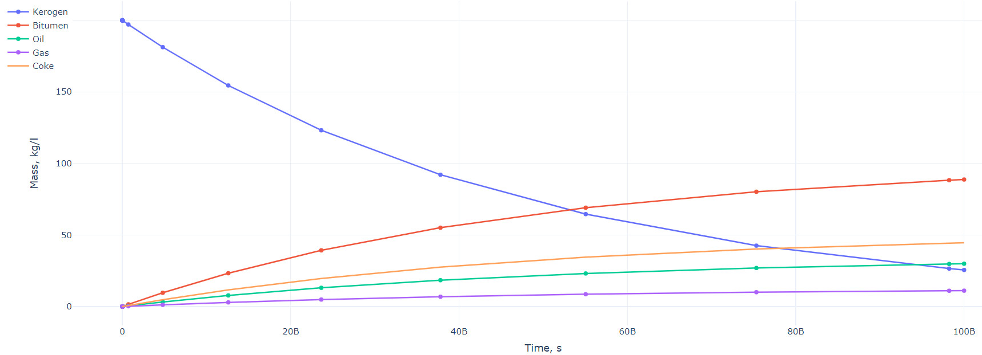
Graph of changes in the mass of components over time (for T = 100 ℃)

Slide 12
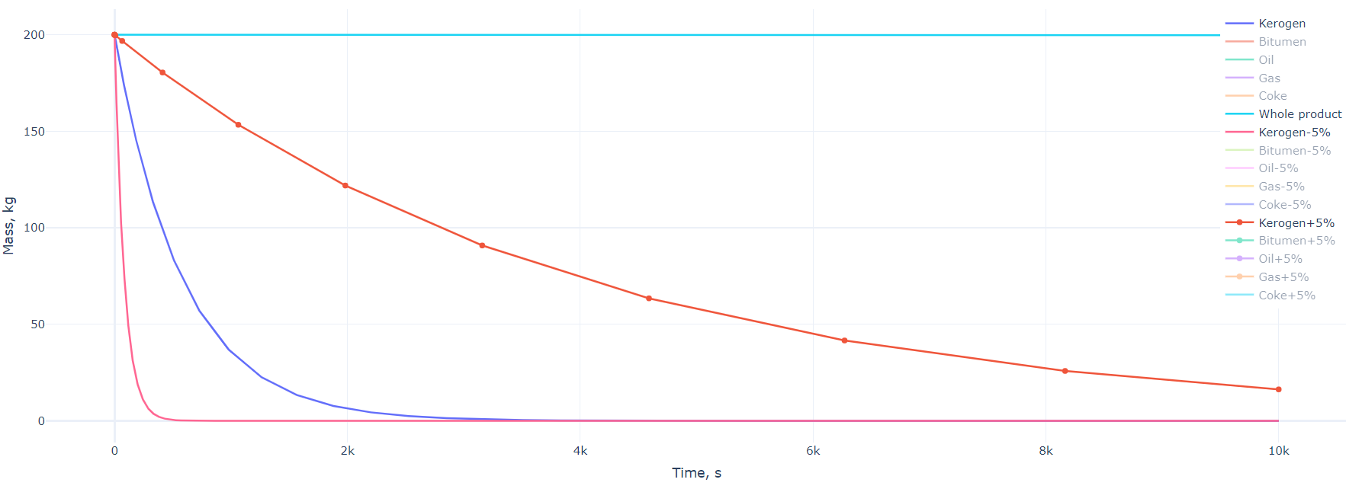
How +/- 5% alteration of activation energy influence the final results

Slide 13
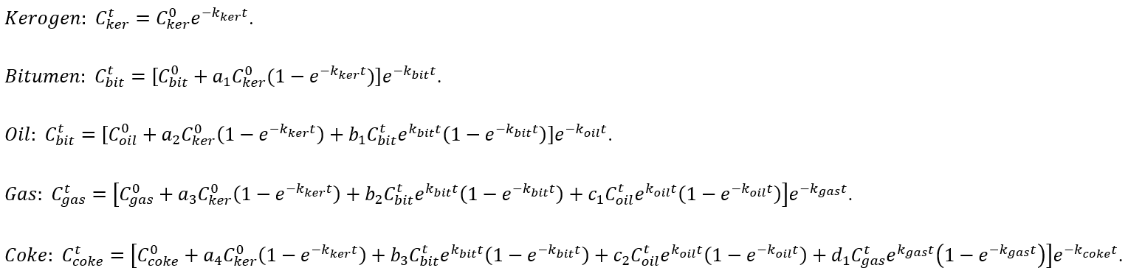
Analytical solution for isothermal transformation of products

Slide 14
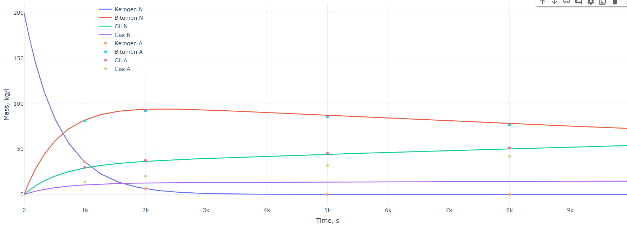
Comparison with numerical results

Slide 15
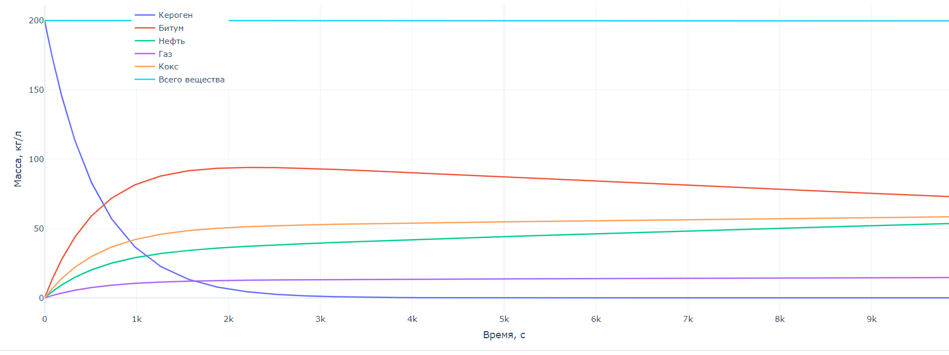
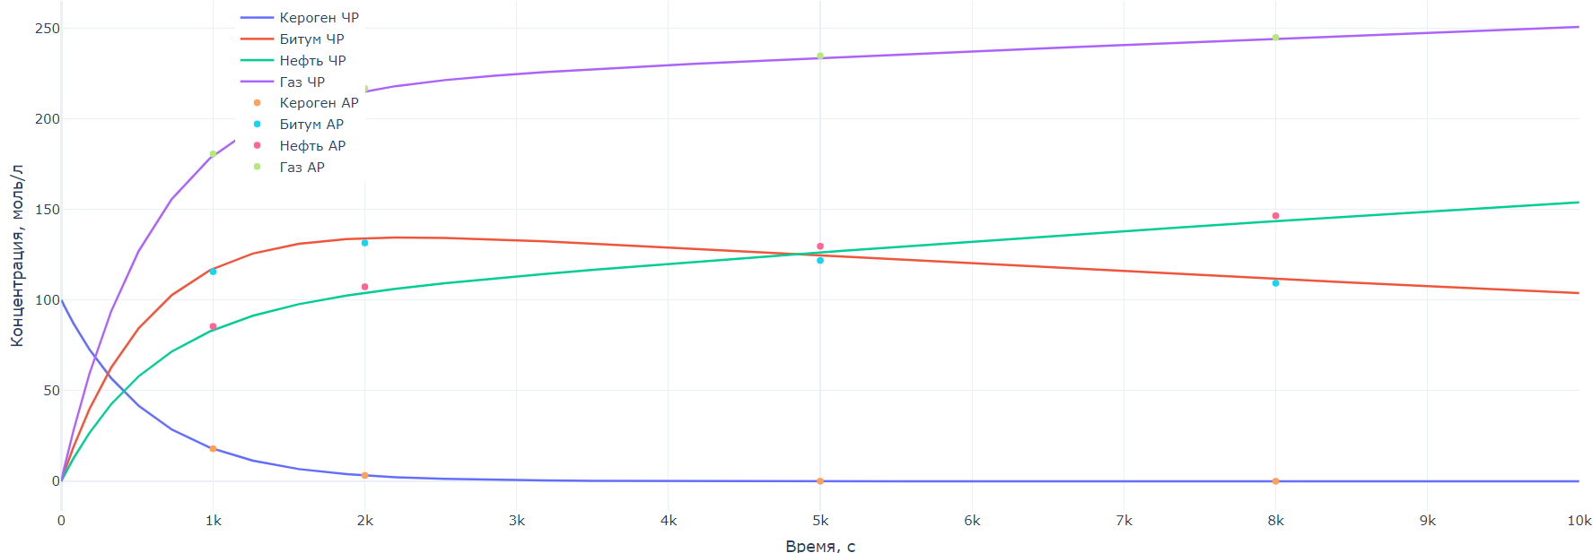
Comparison with numerical results
Не тот график, нужно вставить график, где больше компонентов

Slide 16
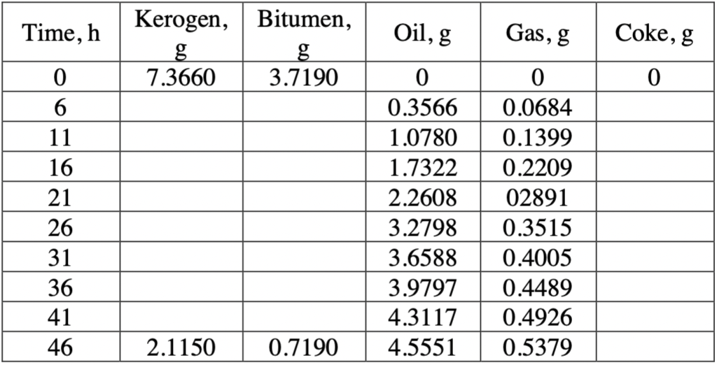
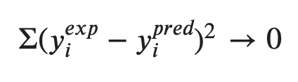
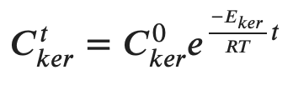
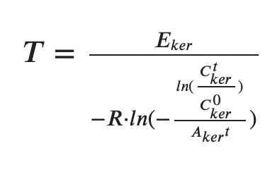
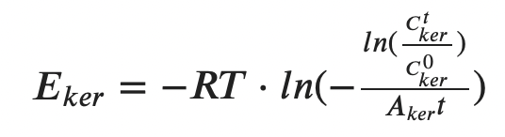
Non-linear fitting with experimental data
Find true parameters methods
scipy.optimize.curve_fit
scipy.optimize.leastsq
unphysical solution

Slide 17
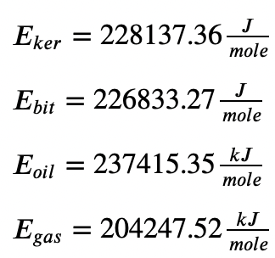
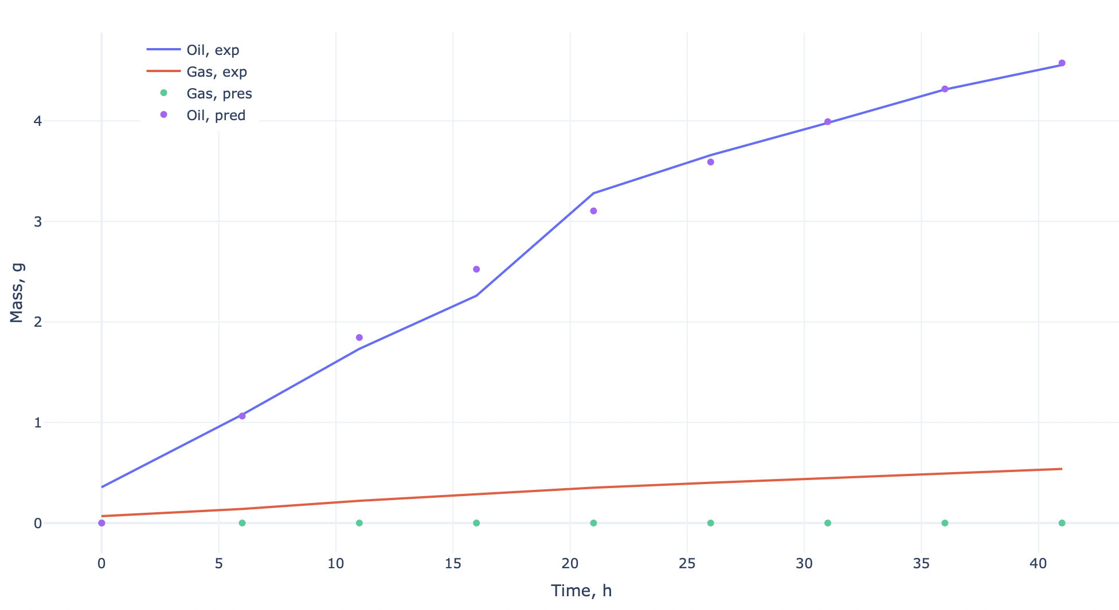
Case 1. Fix A, T and find optimal E

Slide 18
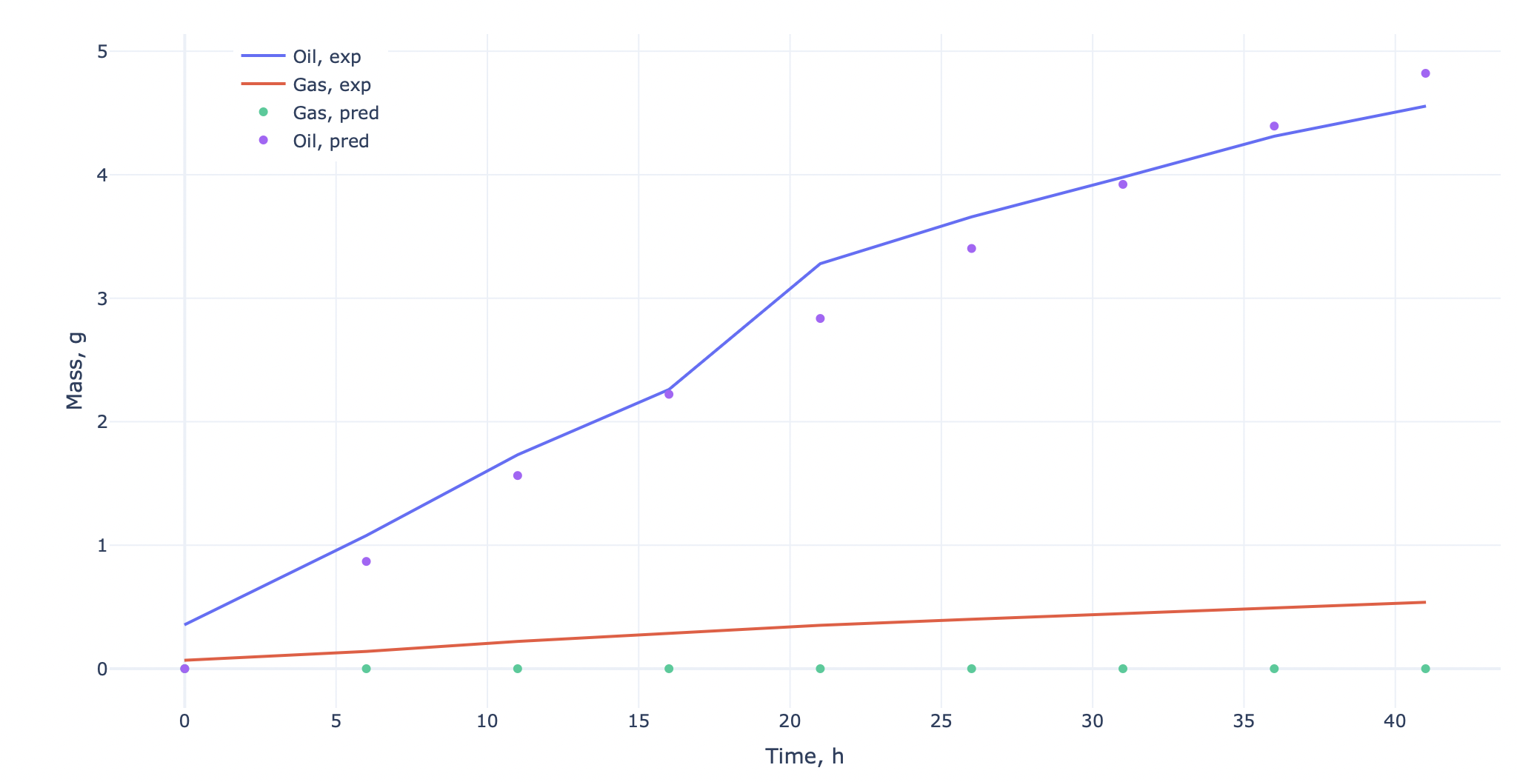
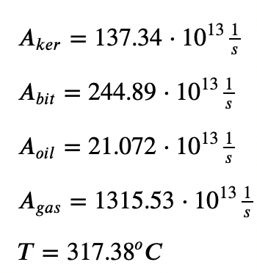
Case 2. Fix E and find optimal A, T

Slide 19
Prediction other experimental data
Time, h | Kerogen, g | Bitumen, g | Oil, g | Gas, g | Coke, g | Mat. balance
0 | 7,37 | 3,20 | 0,00 | 0,00 | 0,00 | 10,56
6 | 6,26 | 3,12 | 0,36 | 0,07 | 0,77 | 10,56
11 | 5,47 | 2,92 | 1,08 | 0,14 | 0,97 | 10,56
16 | 4,77 | 2,69 | 1,73 | 0,22 | 1,15 | 10,56
21 | 4,17 | 2,45 | 2,26 | 0,29 | 1,20 | 10,56
26 | 3,64 | 2,22 | 3,28 | 0,35 | 1,28 | 10,56
31 | 3,18 | 1,99 | 3,66 | 0,40 | 1,34 | 10,56
36 | 2,77 | 1,31 | 3,98 | 0,45 | 2,05 | 10,56
41 | 2,42 | 1,09 | 4,31 | 0,50 | 2,25 | 10,56
46 | 2,16 | 0,72 | 4,56 | 0,53 | 2,61 | 10,56

Slide 20
Conclusion
Petroleum generation modeling is widely used in the analysis of the formation of sedimentary basins. And such modeling helps us estimate potential hydrocarbon reserves
Based on Arrhenius law we conclude that the temperature and the activation energy can change the rate of reaction dramatically
We can determine the necessary parameters from the experimental data, fixing some and optimizing others, using the obtained analytical solution

